Slide 1

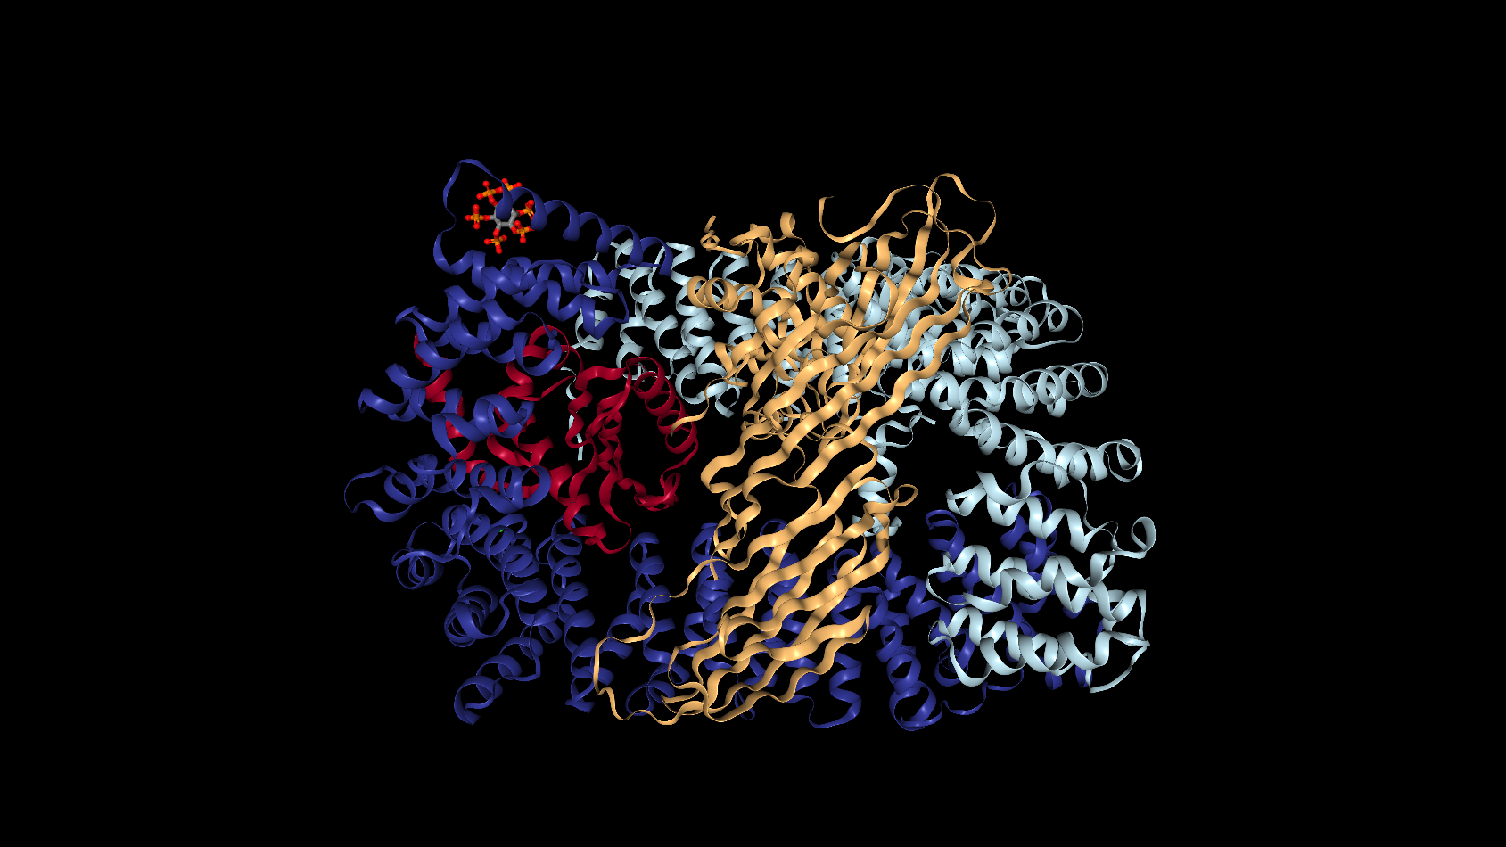
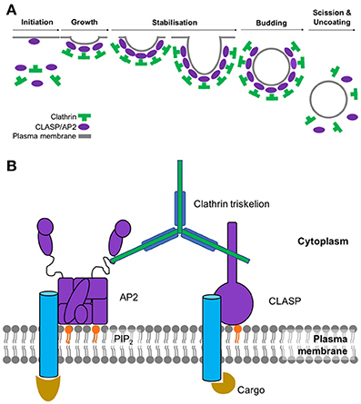
Analysis of Motif Distributions in Regions of Endocytic Proteins
Chante Bethell¹ and Stephanie J. Spielman, PhD²
Department of Molecular and Cellular Biology¹ and Department of Biological Sciences²
Abstract
A short linear motif (SLiM) is a recurring pattern of approximately three to ten amino acids found in proteins. SLiMs are important for cellular signaling and the regulating of proteins, often times by acting as binding sites for protein-binding domains. While SLiMs exist both in ordered regions of proteins where there is a tertiary structure and in disordered regions where there is no structure, they are primarily functional in disordered regions. An important example of SLiM-mediated processes and the focus of this study is endocytosis. Endocytosis is the process by which cells engulf molecules from the extracellular environment. There are specific motifs that mediate and trigger endocytosis. However, the short length of motifs means that it is easy to overlook those that may be important to biological functions. The goal of this study is to identify previously unrecognized proteins that may be involved in endocytosis by analyzing the distribution of motifs in the ordered and disordered regions of the human proteome. Using a bioinformatics approach, we systematically searched the entire human proteome for motifs known to be involved in endocytosis. We hypothesize that the proteins we find to be enriched with motifs in disordered regions may be functionally important for endocytosis. These proteins will be targeted for experimental validation.
Candidate CME Genes Identified
Protein name⁴ | UNIPROT accession ID | Disordered Protein Count | Ordered Protein Count | Motif | Protein Function⁴
Insulin receptor substrate 2 | Q9Y4H2 | 17 | 1 | YXX[LIMFV] | may regulate cellular processes through insulin
Insulin receptor substrate 1 | P35568 | 14 | 0 | YXX[LIMFV] | may regulate cellular processes through insulin
Transport protein Sec24B | O95487 | 11 | 2 | YXX[LIMFV] | contributes to the formation of transport vesicles from the endoplasmic reticulum (ER)
Protein PRRC2A | P48634 | 10 | 0 | YXX[LIMFV] | may be involved in regulating pre-mRNA splicing
Mucin-16 | Q8WXI7 | 10 | 1 | YXX[LIMFV] | serves as protection and lubrication against particles (non-infectious and infectious) at the mucosal surfaces
Trichohyalin | Q07283 | 14 | 1 | X[DE]XXXL[LI] | an intermediate filament-associated protein that combines with keratin intermediate filaments of the hair follicle cells
Uncharacterized protein FLJ40521 | Q8N7P7 | 12 | 0 | X[DE]XXXL[LI] | It is a believed that this is a transcription regulating protein
Golgin subfamily A member 6-like protein 4 | A6NEF3 | 11 | 0 | X[DE]XXXL[LI] | a component of the Golgi apparatus
Coiled-coil domain-containing protein 136 | Q96JN2 | 11 | 0 | X[DE]XXXL[LI] | may be involved in the formation of acrosomes (in spermatogenesis and fertilization)
Mucin-17 | E7EPM4 | 9 | 0 | X[DE]XXXL[LI] | may be involved in maintaining homeostasis at mucosal surfaces
Receptor protein-tyrosine kinase | E9PFD7 | 3 | 0 | NPXY | may be involved in ATP binding and transmembrane receptor protein-tyrosine kinase signaling activity
Transmembrane channel-like protein | F5GYU8 | 3 | 0 | NPXY | an integral part of the plasma membrane
Calreticulin | K7EJB9 | 3 | 0 | NPXY | found in the endoplasmic reticulum (ER)
Calmegin | O14967 | 3 | 0 | NPXY | required for normal male fertility because it acts as a chaperone for various proteins important for sperm adhesion to the egg
Receptor protein-tyrosine kinase | B4DTR1 | 2 | 0 | NPXY | found in the cytosol and plasma membrane
Mucin-19 | Q7Z5P9 | 119 | 1 | [ST]XXXX[LI] | may be involved in ocular mucus homeostasis
Mucin-17 | E7EPM4 | 114 | 1 | [ST]XXXX[LI] | may be involved in maintaining homeostasis at mucosal surfaces
Mucin-4 | A0A0G2JR46 | 72 | 0 | [ST]XXXX[LI] | may be involved in epithelial structure maintenance and in the regulation of signaling receptor activity
Kruppel-like factor 18 protein | A0A0U1RQI7 | 51 | 1 | [ST]XXXX[LI] | may be involved in transcription regulation, metal ion binding and nucleic acid binding
Adenomatous polyposis coli protein | P25054 | 42 | 7 | [ST]XXXX[LI] | a tumor suppressor that plays a role in hepatocyte growth factor (HGF)-induced cell migration
Figure 3: This plot shows the CME proteins we chose as controls (the five subunits of AP2 and the associated kinase, AAK1) and their counts of instances in disordered versus ordered regions found across 6 endocytic motifs.
Conclusion
The results do not support the hypothesis.
The distribution of motifs in the disordered versus ordered regions are not always enriched in endocytotic proteins as displayed in the first plot.
However, enriched proteins across the human proteome that can be targeted for further experimental testing for involvement in endocytosis have been identified.
Many of these identified proteins are not identified in the Eukaryotic Linear Motif (ELM) database, so they are potentially good candidate genes.
Figure 1: The AP2 Protein Adaptor Complex, colored by its subunits: AP2A, AP2B1, AP2S1, AP2M1.¹
Availability
https://github.com/cbethell/motifs
Figure 2A: Steps of the clathrin-coated pit formation.² Figure 2B: The major players in the initiation of CME. The cargo binds to its respective transmembrane receptor, which AP2 then binds to in order to create a bridge to clathrin.²
Bibliography
RCSB Protein Data Bank. (n.d.). 4UQI. Retrieved April 10, 2019, from https://www.rcsb.org/3d-view/4UQI/1
Smith SM, Baker M, Halebian M and Smith CJ (2017) Weak Molecular Interactions in Clathrin-Mediated Endocytosis. Front. Mol. Biosci. 4:72. doi: 10.3389/fmolb.2017.00072
Tidyverse. (n.d.). Retrieved from https://www.tidyverse.org/
UniProt: A worldwide hub of protein knowledge. (2018). Nucleic Acids Research, 47(D1). doi:10.1093/nar/gky1049
The adjacent plots represent heatmaps of proteins organized by their distribution in the disordered and ordered regions for the YXX[LIMFV], X[DE]XXXL[LI], NPXY, and [ST]XXXX[LI] motifs, respectively. Each rectangle is labeled with a number representing the number of proteins that have the same number of instances in the ordered and disordered regions. The rectangles found higher above the green one to one line on each plot represent the proteins that are enriched in the disordered regions.
The plot for the [ST]XXXX[LI] motif differs in that a hexagonal heatmap is used to better visualize the distribution of proteins in the disordered and ordered regions. Similar to the other three plots, each hexagon is labeled with a number representing the number of proteins that have the same number of instances in the ordered and disordered regions, while the green line is a one to one line used to determine which proteins are enriched in the disordered regions and should be targeted based on our hypothesis.
YXX[LIMFV]
X[DE]XXXL[LI]
NPXY
[ST]XXXX[LI]

